Slide 1

Introduction to Scilab
Hands-on Workshop
S. RIYASDEEN
Assistant Professor of Mathematics,
Khadir Mohideen College,
Adirampattinam
08.08.2025
@ ADM College for Women, Nagapattinam

Slide 2
AGENDA
1
What is Scilab?
6
Plotting in Scilab
2
Why Use Scilab?
7
Control Structures
3
Installing Scilab
8
Functions
4
Scilab GUI Tour
9
Resources
5
Basic Commands
10
Q&A + Discussion

Slide 3
What is SCILAB?
Scilab = Scientific Laboratory
Free and open-source alternative to MATLAB
Developed by Inria (France)
Widely used for:
Mathematics & simulation
Control system design
Signal and image processing
Optimization problems

Slide 4
What is SCILAB?
Open source (FREE)
Easy syntax
Powerful built-in functions
Good for engineering and scientific problems
Extensible with toolboxes
Supports plotting, GUI, interfacing with C/C++, Python

Slide 5
Installing Scilab
Go to https://www.scilab.org/download
Choose your OS (Windows/Linux/Mac)
Install like regular software
Open Scilab GUI → Editor + Console

Slide 6
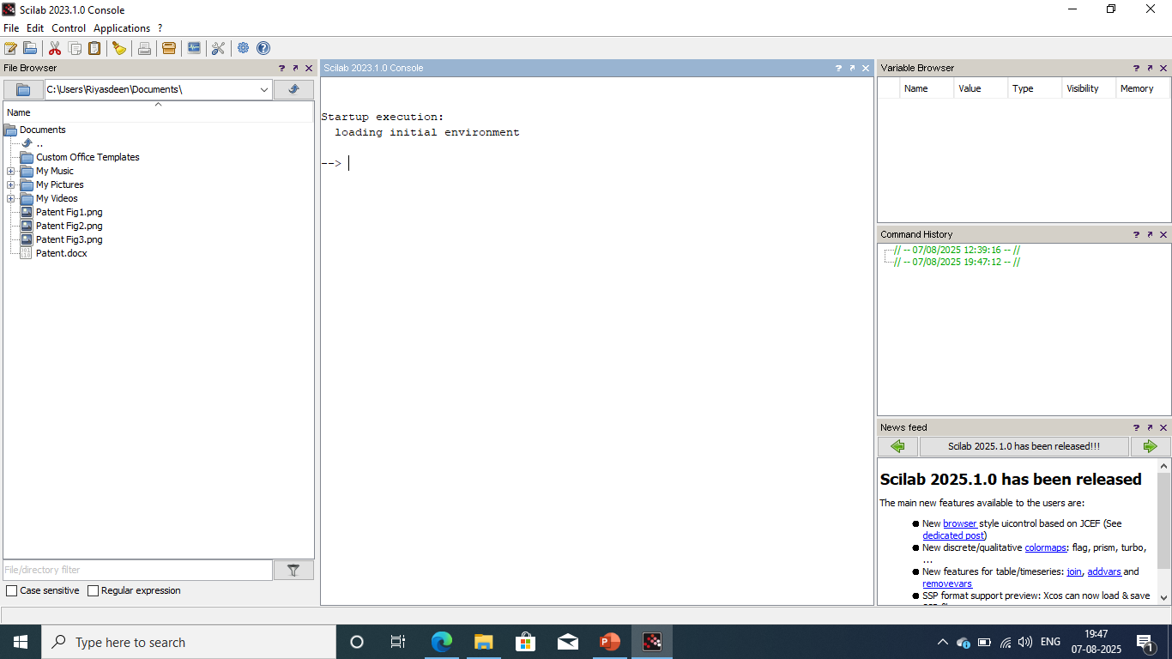
Scilab GUI Tour
Console – for commands
Editor – for writing scripts
Graphics window – for plots
File browser – for managing files

Slide 7
Basic Commands
Variable assignment:
a = 5;
b = 3.2;
name = "Scilab";
Vectors & matrices:
v = [1 2 3 4];
A = [1 2; 3 4];
Access elements:
v(3) // 3rd element
A(2,1) // Row 2, Column 1
Modify values:
v(2) = 10;
Matrix operations:
A = [1 2; 3 4];
B = [5 6; 7 8];
Addition: A + B
Subtraction: A – B
Multiplication: A * B
Element-wise (Hadamard): A .* B
Inverse: inv(A)
Transpose: A’
Determinant: det(A)
Math functions:
x = 0.5;
sin(x)
cos(x)
exp(x)
log(x)
sqrt(x)
abs(-3)
Creating Ranges and linspace
x = 1:5; // [1 2 3 4 5]
x = 0:0.1:1; // [0 0.1 0.2 ... 1]
x = linspace(0, 2*%pi, 100); // 100 points between 0 and 2π

Slide 8
Basic Commands
Display and Input:
disp("Hello Scilab"); // Display text
disp(a); // Display variable
x = input("Enter a number: "); // Take input from user
Special Variables:
%pi → π
%e → Euler's number (≈ 2.718)
%i → imaginary unit
%nan → Not-a-Number
%inf → Infinity
Useful Commands:
clc // Clear console
clear // Clear all variables
who() // List all variables
pwd() // Current directory
cd('C:/Users/YourName/Desktop') // Change directory

Slide 9
Plotting in Scilab
Basic Plot
x = 0:0.1:2*%pi;
y = sin(x);
plot(x, y);
Labels: xlabel(), ylabel(), title()
Grid: xgrid()

Slide 10
Control Structures in Scilab
IF
a = 10;
if a > 5 then
disp("a is greater than 5");
end
IF-ELSE
a = 3;
if a > 5 then
disp("Greater than 5");
else
disp("Less than or equal to 5");
end

Slide 11
Control Structures in Scilab
IF-ELSEIF-ELSE
grade = 85;
if grade >= 90 then
disp("A");
elseif grade >= 80 then
disp("B");
elseif grade >= 70 then
disp("C");
else
disp("Fail");
end
FOR
for i = 1:5
disp("i = " + string(i));
end
WHILE
x = 1;
while x <= 5
disp(x);
x = x + 1;
end
break → exit loop early
continue → skip to next iteration

Slide 12
FUNCTIONS
Define your own functions:
function y = square(x)
y = x^2;
endfunction
Call with square(3) → 9

Slide 13
Resources
Scilab official site: https://www.scilab.org
Tutorials: https://help.scilab.org/
YouTube: "Scilab for Beginners“
Books and eBooks

Slide 14
Q&A + Discussion
Email: riyasafrim@kmc.edu.in
Website: www.kalvikraft.in

